Slide 1
Resume Analysis Chatbot using NLP
Group 9
Team Member: Arjun Pesaru

Slide 2


Abstract of the Project
Content:
Objective: "This project aims to create a Resume Analysis Chatbot that utilizes NLP techniques to analyze resume content, categorize candidates into job fields, and recommend skills and courses for career development."
Approach: "The project involves data preprocessing, model training, and the development of a user interface to interact with the model."
Outcome: "An effective and scalable solution for resume screening that can be integrated into hiring platforms."

Slide 3

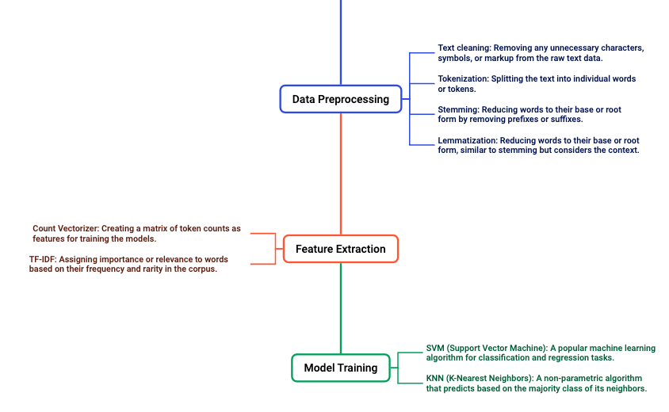
Model Training and Calibration
Implementing a robust model training pipeline with relevant preprocessing steps

Slide 4

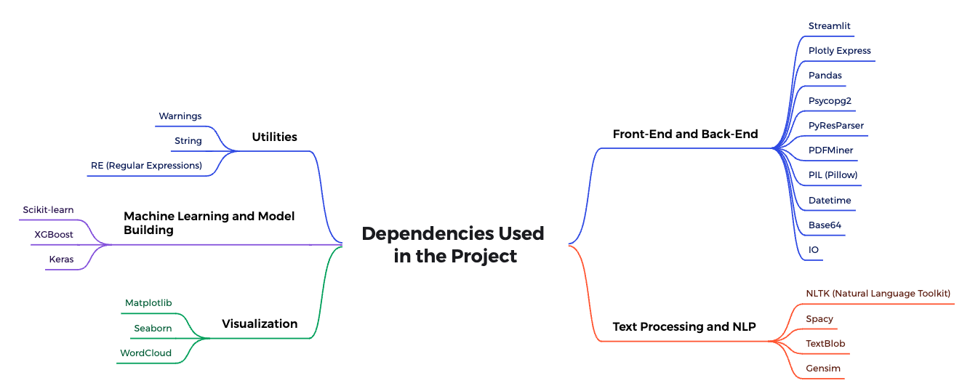
Dependencies Used in the Project

Slide 5

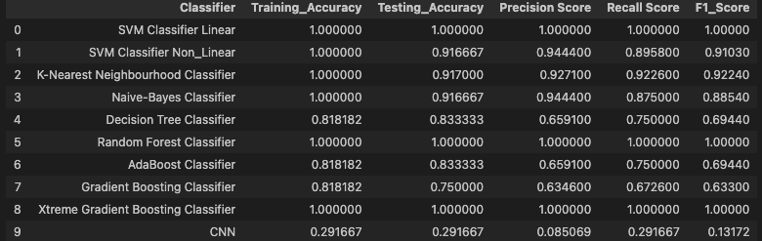
Classifier Performance Comparison
Best Performing Model: The Light Gradient Boosting Classifier achieved perfect scores across all metrics, indicating that it was the most effective at both learning from the training data and generalizing to new, unseen data.
Potential Overfitting: Some models like the SVM and Naive-Bayes Classifiers performed perfectly on the training data but had lower testing accuracy, which might indicate potential overfitting.
Balanced Models: The Random Forest Classifier also performed exceptionally well, with a perfect F1 score, indicating a good balance between precision and recall.
This table provides a comprehensive overview of the model performances, helping to identify the best classifier for the Resume Analysis Chatbot project.

Slide 6

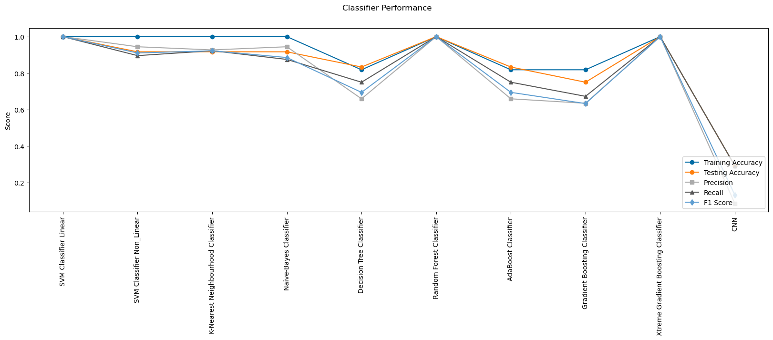
Classifier Performance Visualization
This visualization provides a clear comparative view of how different classifiers perform across critical metrics. It highlights the strengths and weaknesses of each model, helping to identify which model offers the best balance between accuracy, precision, recall, and F1 score for the Resume Analysis Chatbot project.

Slide 7
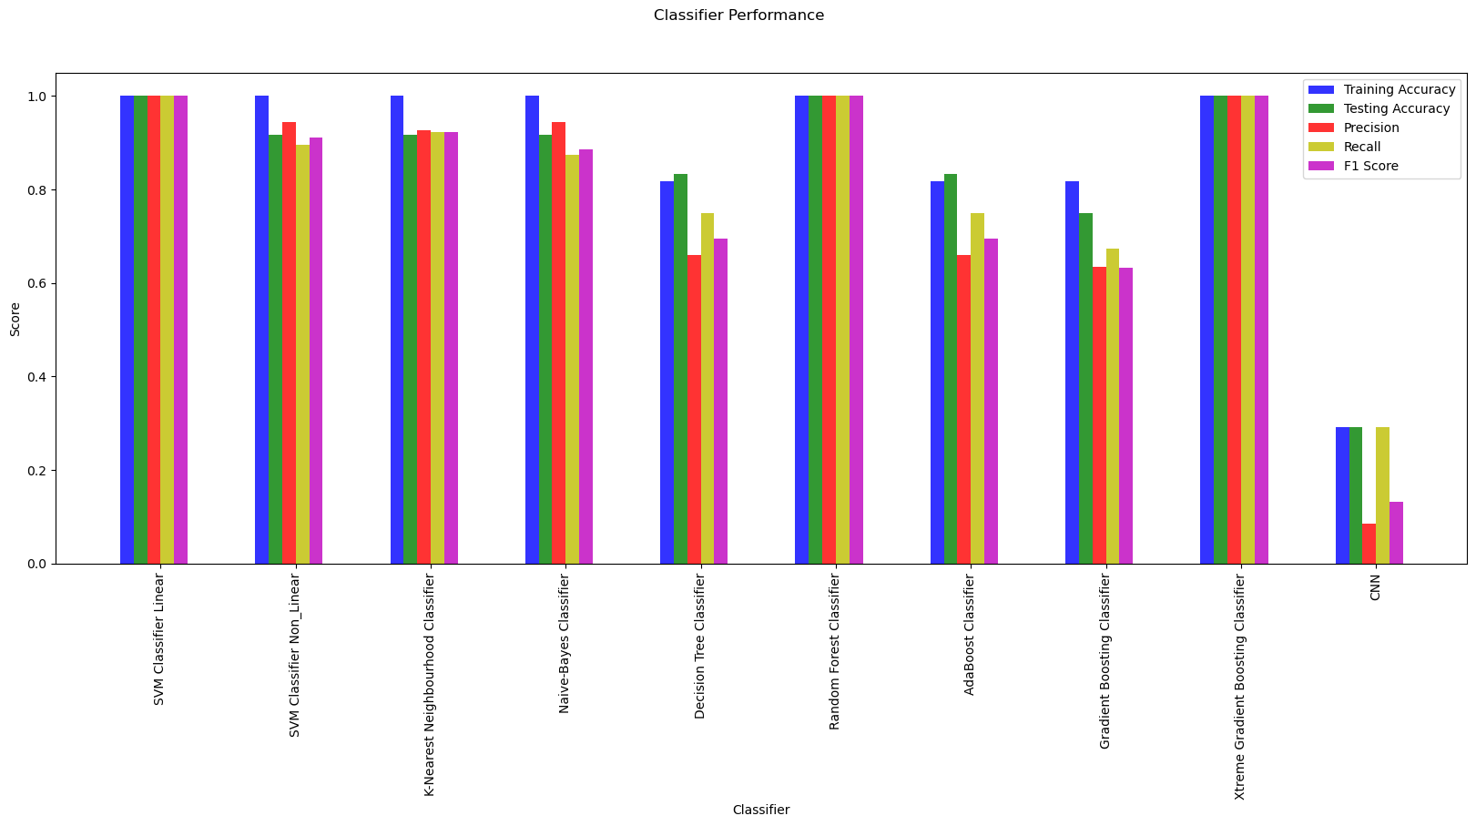
Classifier Performance Visualization
Best Overall Performers: Random Forest and XGBoost classifiers are the best overall performers, with high scores across all metrics, indicating that they effectively balance precision, recall, and generalization.
Usefulness of the Chart: This bar chart provides a clear and straightforward visual comparison of the models, helping to quickly identify which classifiers performed best across multiple evaluation criteria.

Slide 8

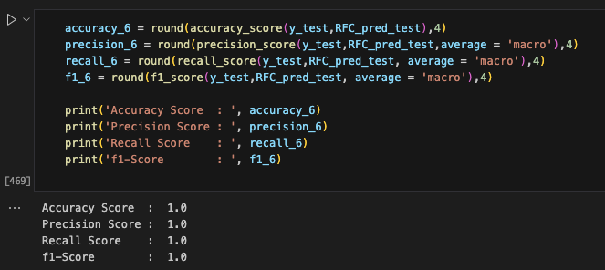
Best Performing Classifier
Among all those models random forest model gives more accuracy.

Slide 9

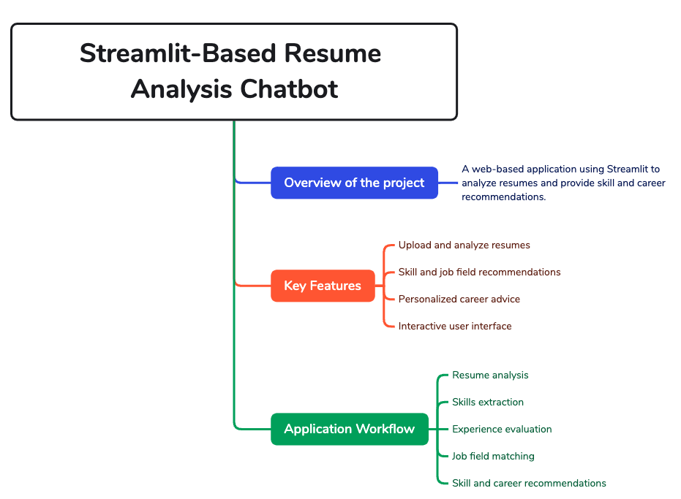
Chatbot and its features

Slide 10

Setup & Database Initialization
Content:
Libraries Used:
Streamlit, NLTK, Spacy: For creating the web interface and processing text.
Psycopg2: For database interaction with PostgreSQL.
PDFMiner3: For extracting text from PDFs.
Database Initialization:
Setting up a PostgreSQL database with a table (user_data) to store user details and analysis results.
Connection Setup:
Functions to initialize the database and create a connection for storing and retrieving data.

Slide 11
Data Management and Visualization
Content:
Data Insertion:
Storing user data (name, email, resume score, etc.) into the PostgreSQL database using insert data function.
Admin Panel:
Allows viewing and managing all user data in a tabular format.
Visualization:
Creating interactive pie charts to show distributions of job fields and user experience levels using Plotly Express.

Slide 12

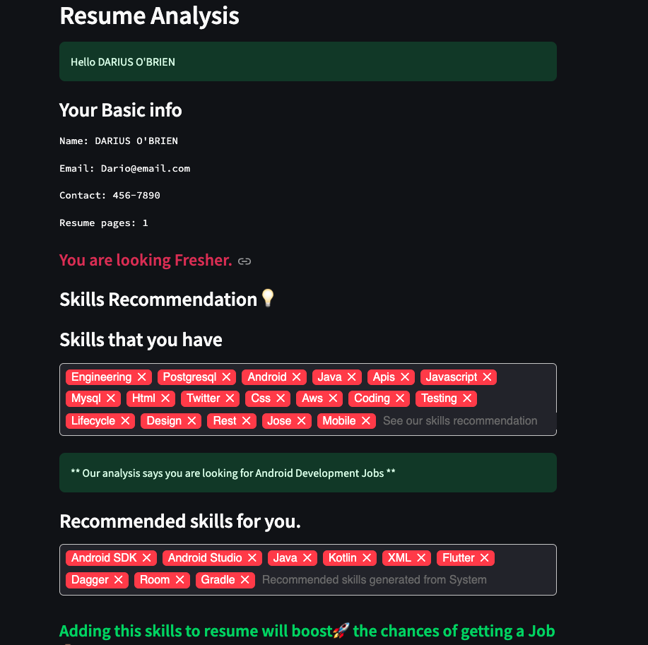
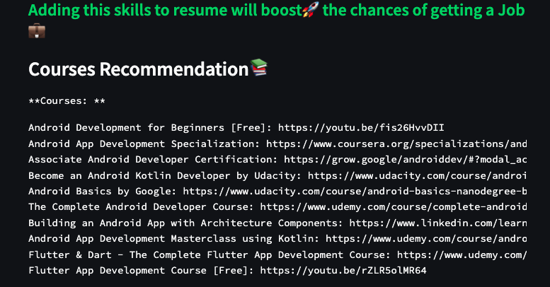
User Interface
User Engagement: The slide effectively demonstrates how the Resume Analysis Chatbot interacts with users, offering personalized feedback and actionable advice.
Value Addition: By suggesting relevant courses and additional skills, the chatbot not only analyzes the user's current capabilities but also actively contributes to their career development.
Comprehensive Feedback: The combination of detailed skill analysis, job field prediction, and educational resources ensures that users receive a well-rounded evaluation of their resumes, with clear next steps for improvement.

Slide 13

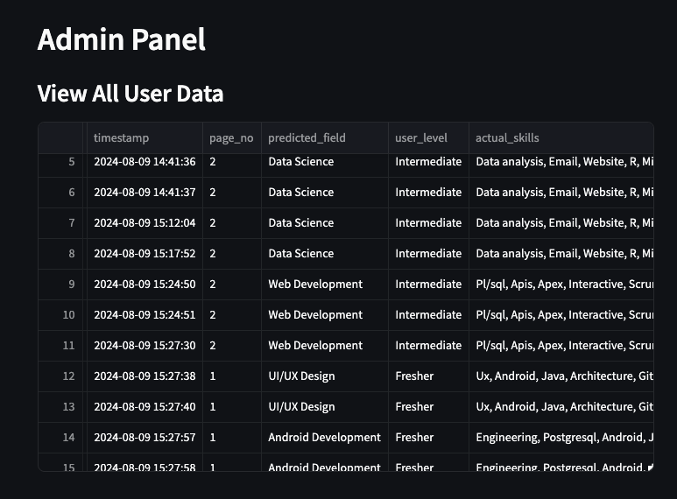
Admin Interface
Summary:
This image effectively demonstrates the backend functionality of our project and highlights the importance of data management in delivering personalized recommendations through the chatbot.

Slide 14
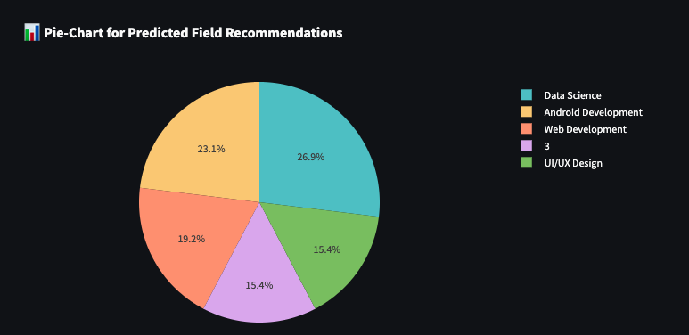
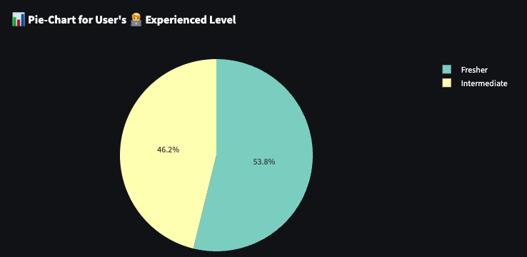
Admin Insights Generated
This slide presents two pie charts that provide visual insights into the data collected by the Resume Analysis Chatbot.

Slide 15

Conclusion and Future Scope
Summary:
The application effectively analyzes resumes, provides recommendations, and manages data.
Future Work:
Expand job field categories.
Incorporate advanced NLP techniques.
Proposals for improving model accuracy, expanding job categories, and enhancing the user interface.
Enhance the admin panel with more features and user roles.

